Slide 1
Final Engagement
Attack, Defense & Analysis of a Vulnerable Network

Slide 2
Scope
Vulnerabilities
Mitigation Strategy
Malicious Activities

Slide 3
Table of Contents
This document contains the following resources:
Scope
Network Topology & Critical Vulnerabilities
Hardening
Malicious Activities

Slide 4
Network Topology
& Critical Vulnerabilities
4

Slide 5
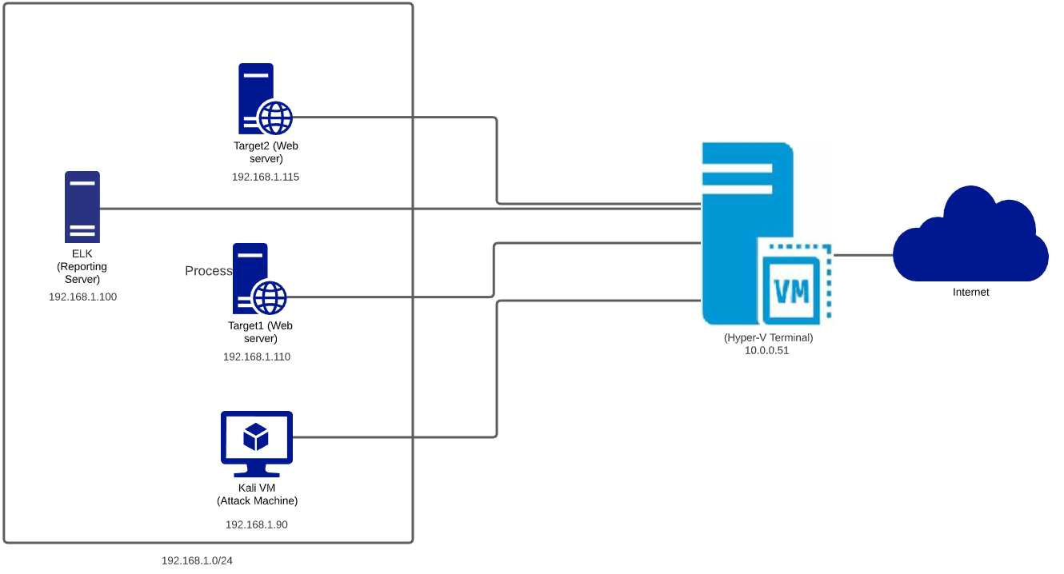
Network Topology
Network:
Address Range: 192.168.1.0/24
Netmask: 255.255.255.0
Gateway: 10.0.0.51
Machines
IPv4: 192.168.1.110
OS: Ubuntu 18.04.4 LTS
Hostname: ELK
IPv4: 192.168.1.110
OS: Debian GNU/Linux 8
Hostname: target1
IPv4: 192.168.1.115
OS: Debian GNU/Linux 8
Hostname: target2
IPv4: 192.168.1.90
OS: Kali GNU/Linux
Hostname: Kali
Use draw.io to create a diagram of the network.
Add your diagram to this slide and fill out the data in the sidebar.

Slide 6
Critical Vulnerabilities: Target 1
Our assessment uncovered the following critical vulnerabilities in Target 1.
Vulnerability | Description | Impact
CVE-2008-5161 | ssh remote login was active at the user level with port 22 being open. | The attacker will get the access to the shell using Hydra or similar Tool.
CVE-2019-15653 | html password disclosure - The password hash is viewable in plaintext | The HTML source code of the login page contains values that allow obtaining the username and password. The username are password values are a double md5 of the plaintext real value, i.e., md5(md5(value)).
CWE-548-Exposure of Information Through Directory Listing | A directory listing provides an attacker with the complete index of all the resources located inside of the directory. The specific risks and consequences vary depending on which files are listed and accessible. | The attacker will get hold of sensitive information

Slide 7
Critical Vulnerabilities: Target 2
Our assessment uncovered the following critical vulnerabilities in Target 2.
Vulnerability | Description | Impact
CVE-2016-10033 PHPMailer | The mailSend function in the isMail transport in PHPMailer | allow remote attackers to pass extra parameters to the mail command and consequently execute arbitrary code via a \" (backslash double quote) in a crafted Sender property
UDF Local Privilege Escalation Exploit 1518 | MySQL User-Defined function Dynamic Library Local Privilege Escalation | The attacker will gain access the root user
CVE-2008-5161 | ssh remote login was active at the user level with port 22 being open. | The attacker will get the access to the shell using Hydra or similar Tool.
CWE-548- Exposure of Information Through Directory Listing | A directory listing provides an attacker with the complete index of all the resources located inside of the directory. The specific risks and consequences vary depending on which files are listed and accessible. | The attacker will get hold of sensitive information

Slide 8

Hardening
8

Slide 9
Hardening Against CVE-2008-5161 on Target 1
Vulnerability -1: CVE-2008-5161 SSH Login and Brute Force Attacks
Why the patch works: : It limits the number of attempts the attacker can commit. Only allows connections from trusted addresses. Disabling SSH from outside network will prevent anyone to login to the server
How to install it (include commands):
Disable ssh login by changing configuration to /et/ssh/sshd_config file
At Firewall enable Allow to whitelist source for ssh login and Deny all.
Monitor Audit logs
Enforce Account lock out policy for wrong passwords
Implementing MFA or 2FA.

Slide 10
Hardening Against CVE-2019-15653 on Target 1
Vulnerability -2: CVE-2019-15653 -Proprietary information including hashed passwords is viewable in plaintext on html pages within the wordpress site
Why the patch works: : The web developers can correct the code prevents exposing the hashed password within the wordpress site
How to install it (include commands):
Notify developers of the error and have it corrected

Slide 11
Hardening Against CWE-548 on Target 1
Vulnerability -3: CWE-548-Exposure of Information Through Directory Listing
Why the patch works: : This will restrict the attacker to find out the directory details of the web server
How to install it (include commands):
The web developers must disable the Directory Listing in all web projects.

Slide 12
Hardening Against CVE-2016-10033 on Target 2
Vulnerability -1: CVE-2016-10033 PHPMailer
Why the patch works: The web server has to be patched with the PHPMailer 6.2 or above as the patch contains necessary fixes for tis vulnerability
How to install it (include commands): PHPMailer is available on Packagist (using semantic versioning), and installation via Composer is the recommended way to install PHPMailer. Just add this line to your composer.json file
composer require phpmailer/phpmailer

Slide 13
Hardening Against UDF Local Privilege Escalation on Target 2
Vulnerability -2: UDF Local Privilege Escalation Exploit 1518
Why the patch works: The patch disable the necessary privilege that the attacker can exploit to escalate the local account privilege
How to install it (include commands):
only database administrators have INSERT privilege on the ‘mysql’ database
mysql> update mysql.user set insert_priv='N' -> where user= ‘<Non_Admin_User>;
The root account should never be remotely accessible
mysql> update mysql.user set host='ip_or_hostname' -> where user='root' and host='%';

Slide 14
Hardening Against CWE-548 on Target 2
Vulnerability -3: CWE-548-Exposure of Information Through Directory Listing
Why the patch works: : This will restrict the attacker to find out the directory details of the web server
How to install it (include commands):
The web developers must disable the Directory Listing in all web projects.

Slide 15
Malicious Activity
15

Slide 16
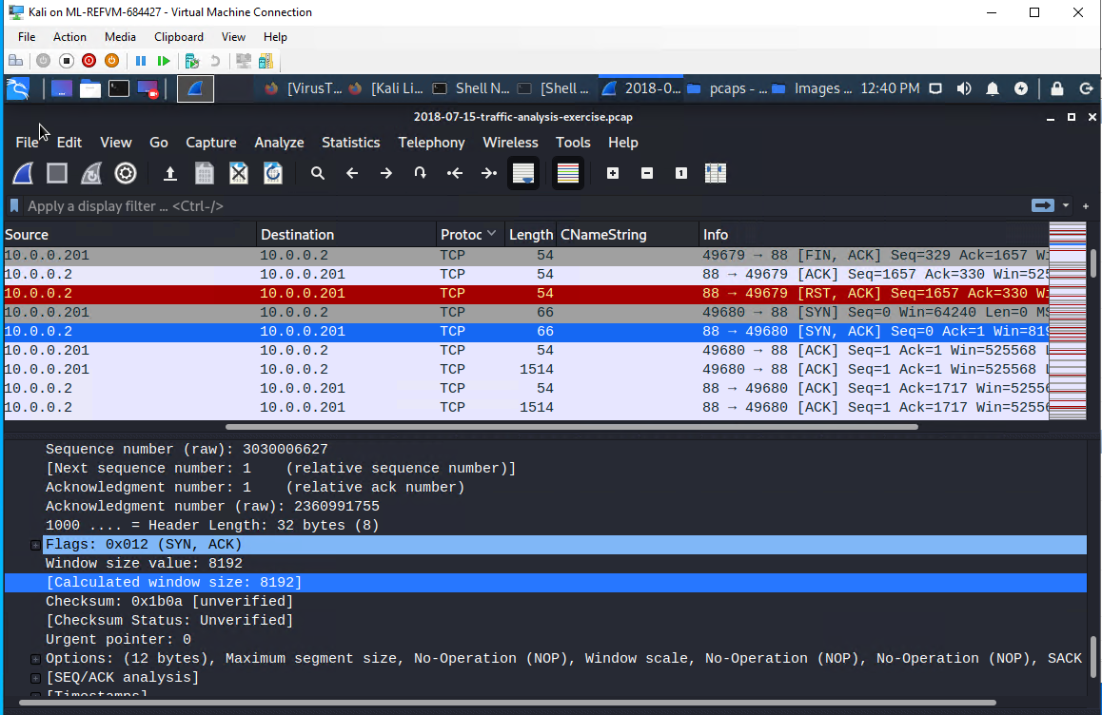
Torrent Downloading
Summarize the following:
Typical Traffic over TCP and HTTP protocol along with lots of search requests and typical keep connection alive.
The user was downloading torrent from http://files.publicdomiantorrents.com
The video file was Betty Boop Rhythm on the Reservation.avi.torrent

Slide 17
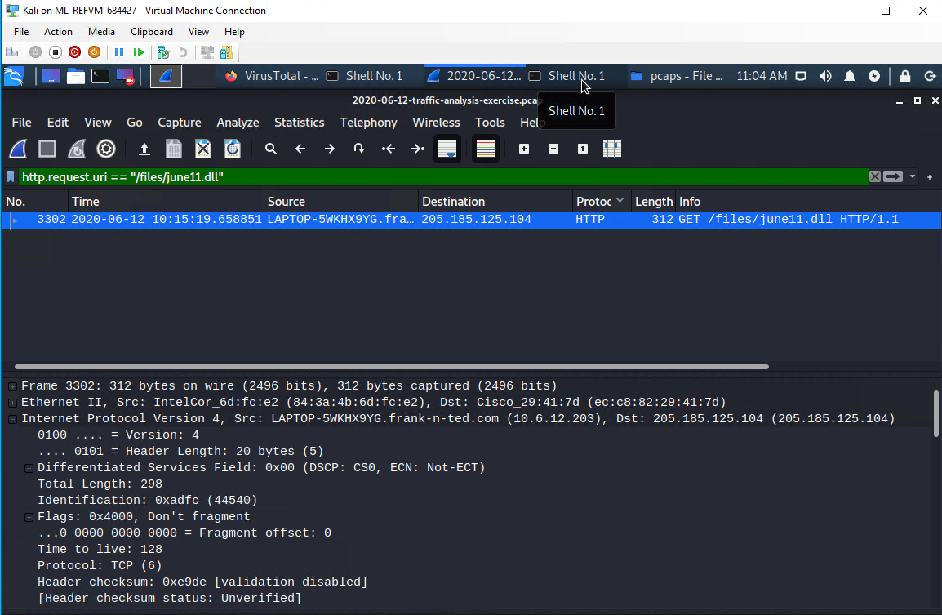
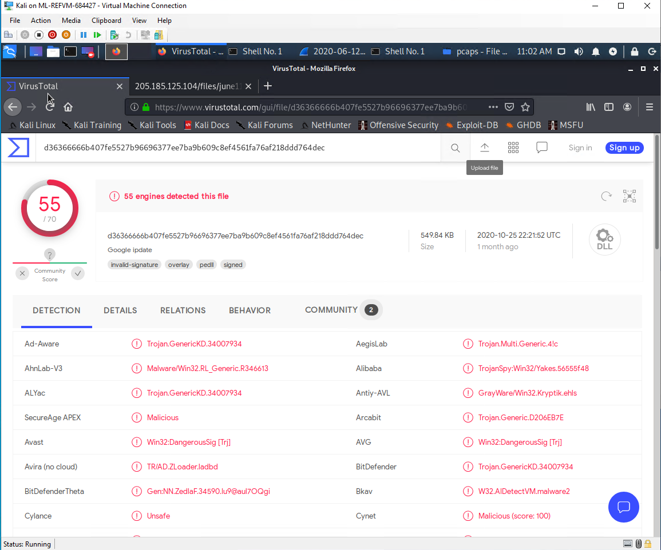
Malware Download
Summarize the following:
HTTP, TCP
The user was browsing and was redirected to a malware webpage and the user downloaded the malware.
june11.dll- A known malware file being downloaded.

Slide 18
The End
18

